Slide 1




Human-Driven Genetic Programming for Program Synthesis: A Prototype
Prof. Thomas Helmuth, James Gunder Frazier, Yuhan Shi, Ahmed Farghali Abdelrehim
11/04/2023
Notes:
Introduction
“We developed a new system/algorithm which we wrote and published about at the 2022 GECCO research conference.”

Slide 2
Neural Networks
Evolutionary Algorithms
Genetic Programming
Simulates the human brain
Produces a model to act like a data set
Requires upwards of millions of example data points
Simulates evolution
Produces a model which works on a problem
Simulates evolution
Requires around 100 “examples” of what the program should accomplish
Produces a solution
Works on a singular problem/data point
A comparison of genetic programming to other popular forms of artificial intelligence
Notes:
Neural Networks
They attempt to simulate the human brain and “learn” through being exposed to massive amounts of training data, normally in the form of inputs and outputs. This learning process occurs by using mathematical formulas to propagate (move information through) the network in two directions: forwards for predicting and backwards for learning. Forwards is extremely fast while backwards is very slow.
Example: Classifiers (for maybe different types of wine), Computer Vision (OCR), anything which requires pattern recognition and/or understanding massive amounts of data points (anywhere from thousands to millions to even billions).
Evolutionary Algorithms
These algorithms attempt to use what is known to researchers in the field as “evolutionary forces/pressure” to drive a system to generate an optimal solution for some given task. Using the cycle shown on the previous page to pseudo-simulate evolution in the biological sense, each generation of the evolutionary cycle (normally) yields better individuals. Evolutionary Algorithms are normally applied to “small” problems
Examples: Lots of work has been done in the field of Graph Theory using EAs to find near-optimal cliques and dominating sets of graphs (one graph at a time). EAs are also used in Machine Learning/Neural Networks to adjust the neural layers to best suit a problem.

Slide 3
Problem Statement
Recent advances in genetic programming allow it to generate general purpose programs similar to those humans write, but require specifications in the form of extensive, labeled training data, a barrier to using it for user-driven synthesis, even for experts. Here we will describe the novel prototype of a Human-Driven Genetic Programming (HDGP) system which, by utilizing Counterexample-Driven GP (CDGP), reduces the required number of initial training cases from one-hundred (100) to only five (5) and simplifies the initialization of genetic programming runs.
Notes:
Genetic Programming can produce general purpose programs to solve problems; however, to setup and begin a GP run is extremely complicated even for experts in the field. We developed a prototype for a new type of Genetic Programming Algorithm and System called Human-Driven Genetic Programming (HDGP) which addresses these issues.

Slide 4
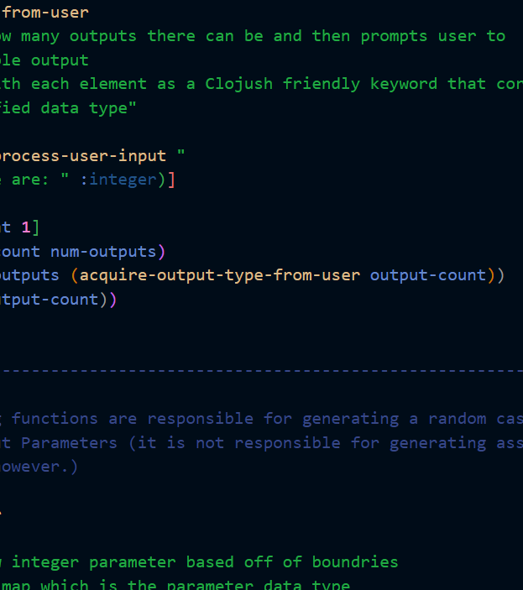
Algorithm Overview
Three parts to make the whole
Human Input
The Evolutionary Cycle
Human Verification
Image Source: https://github.com/jgfrazie/Clojush
Notes:
There are three parts to the algorithm for our system

Slide 5
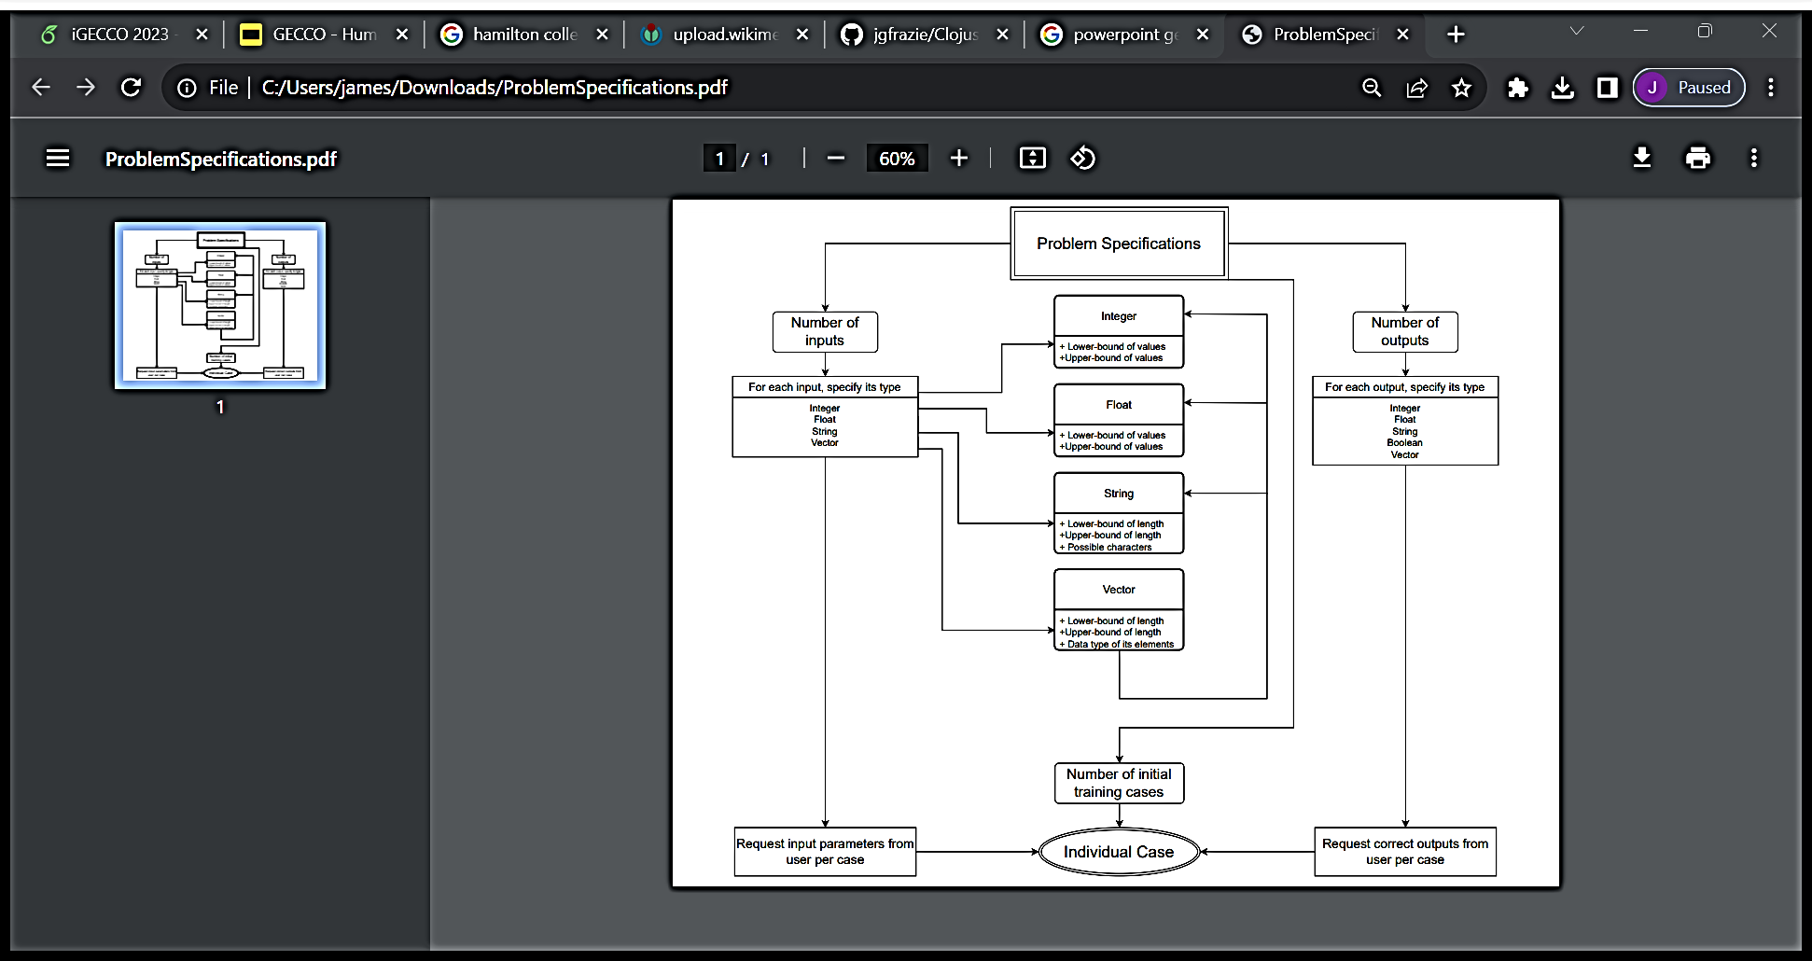
(Source: Helmuth et al., 2023)
Part I: Human-Input
Notes:
Key Takeaway: Three things are needed to be specified by the user to begin a GP run
Number of inputs
Number of outputs
Data specifications for each input & output
i.e., to set up a GP run to find a program that tells if a number is odd or even, you need these things
1 input
1 output
Input is an integer from zero to one million
Output is a Boolean: True for even, False for odd

Slide 6
Initialization
Termination
Evaluation
Parent Selection
Genetic Modification
Part I: Human Input
Part III: Human Verification
Part II: The Evolutionary Cycle
Part II: The Evolutionary Cycle
Notes:
Part II is just the evolutionary cycle used to promote “better” individuals over worse ones. I have inserted parts 1 and 3 into the graphic so you can see where these parts take place

Slide 7
Case 0 : Input: [0] ; Program's output: ["0"] Case 1 : Input: [10000] ; Program's output: [“10000"] Case 2 : Input: [8142] ; Program's output: [“Fizz"] Case 3 : Input: [5581] ; Program's output: ["5581"] Case 4 : Input: [4580] ; Program's output: ["4580"] Case 5 : Input: [2797] ; Program's output: ["2797"] Case 6 : Input: [90] ; Program's output: [“Fizz"] Case 7 : Input: [6589] ; Program's output: ["6589"] Case 8 : Input: [7369] ; Program's output: ["7369"] Case 9 : Input: [3652] ; Program's output: ["3652"] Case 10 : Input: [6988] ; Program's output: ["6988"]
Caption: Outputs from a best program on the Fizz problem: a simplified version of the FizzBuzz problem
Part III: Human Verification (Source: Helmuth et al., 2023)
Notes:
After some evolutionary time, the GP system will find a candidate for the “best solution”. However, it does not know if it solves the problem specified by the user. So, the system presents results in this format.

Slide 8
Case 2 :
Input: [8142] ;
Program's output: [“Fizz"]
Part III: Human Verification
Notes:
The example problem here is Fizz; a variation of FizzBuzz
Divide by 3 gets “Fizz”
Human is responsible for instructing the GP system on which cases the individual got right and wrong so the GP system can either return a model or learn from its mistakes and continue to evolve.

Slide 9


Experiments and results
Problem | Initial Cases | Average Number of Human Verified Cases as Examples | Found a Solution
Subtract Two Integers | 5 | 0
Spaces | 5 | 26
Substring | 5 | 8
Element Rank | 5 | 0
Fizz | 5 | 17
Notes:
Third column is most interesting because it shows that a human was able to influence the evolutionary cycle.

Slide 10
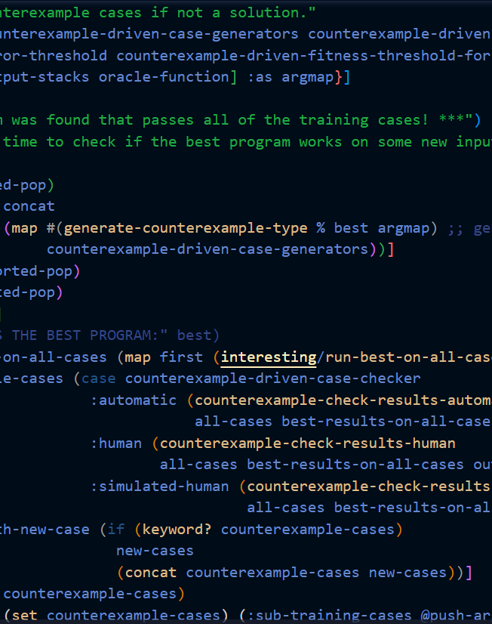
Insights and future work
Humans in the loop
No system has used a human to drive the evolutionary cycle of a GP run before.
Less specifications and cases needed
While others have eliminated specification needs, we have reduced specifications to purely user inputs and outputs. We also reduced the number of training cases needed to start a run from 100 to 5 by utilizing informal Counter-example Driven GP (iCDGP).
Newfound limitations
Issues never considered have been revealed through our prototype. For example, how can a user specify constraints for a problem beyond data type? (i.e., “This array must contain at least one zero”)
Image Source: https://github.com/jgfrazie/Clojush
Notes:
Our work is significant for 3 reasons
1) No one has inserted a human into the evolutionary loop before.
2) We reduced specifications needed to start GP runs down to simple inputs, outputs, and constraints
3) We found new limitations in the field of GP such as “How do we specify non-input/output constraints?”

Slide 11




Contact and Acknowledgements
Special thanks to the following:
Prof. Sarah Morrison-Smith
Yifan Wu
Emily Weinstein
James G. Frazier
Computer Science | Senior Fellow
Hamilton College
✉ jgfrazie@hamilton.edu
🌐 https://jgfrazie.github.io
🌐 https://mochiresearch.com/author/wchtr101/
🌐 https://lspector.github.io/push.html
Prof. Thomas Helmuth
Assistant Professor of Computer Science
Hamilton College
✉ thelmuth@hamilton.edu
🌐 https://cs.hamilton.edu/~thelmuth/
🌐 https://lspector.github.io/push.html
Notes:
Thank you all for listening.

